Slide 1
Reducing InfiniCare’s readmissions with LACE
Lawrence Hsu and Vincent Caruso

Slide 2
Introduction
Risk score to identify and predict patients at risk of readmission
Primary Objectives of Risk Score Development:
Improve quality of care
Reduce cost and resource waste
Improve hospital reputation in the community

Slide 3
Current State of Readmissions
Current readmission rate at InfiniCare is 17.6%
Cost of readmission ~$13,000 per readmission (2013)
National readmission rate decreasing since 2012, but InfiniCare’s rate has remained steady

Slide 4
If we maintain the status quo...
We accept that many patients are receiving inadequate care
Readmission costs may increase due to lower reimbursement rates and increasing federal penalties
Our reputation in the community may suffer
Losing customers to other companies

Slide 5
Solution: LACE score
LACE is a readmission risk score developed by Ottawa Hospital Research Institute
Based on 4 components
L - length of stay
A - acuity of admission
C - comorbidities (Charlson)
E - ED visits in last 6 months
LACE predicts which patients are at high risk of readmission within 30 days

Slide 6
Can we make LACE better for InfiniCare patients?
L + A + .... + E
C = myocardial infarction
+ cerebrovascular disease
+ peripheral vascular disease
+ diabetes without complications
+ congestive heart failure
+ diabetes with complications
+ chronic pulmonary disease
+ mild liver disease
+ any tumor
+ dementia
+ AIDS
+ moderate/severe liver disease
+ metastatic tumor
Predictive value of variables assessed using a logistic regression model

Slide 7
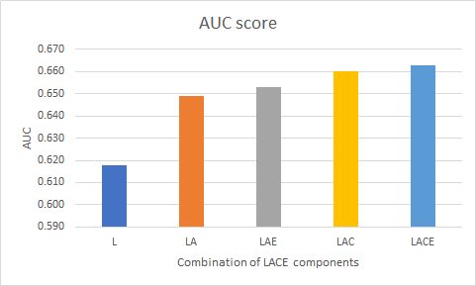
Choosing the optimal LACE model

Slide 8
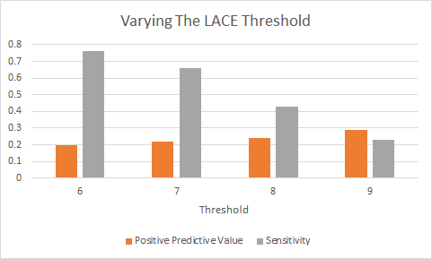
Using LAC(E) to predict readmissions
Notes:
Once we decided on the best version of the LACE model for InifiniCare’s patient population, we wanted to optimize how we would use LACE in a care setting.
What this graph shows is that as the threshold score used to identify high-risk patients goes up, sensitivity decreases, but the positive predictive value of LACE goes up

Slide 9
Predicting readmissions: Return on investment
Risk score | “High risk” threshold | Sensitivity | Correctly predicted readmissions | Overall predicted readmissions | Return on investment
L+A+C | LAC ≥ 6 | 0.76 | 780 | 3867 | 20.2%
L+A+C | LAC ≥ 7 | 0.66 | 680 | 3143 | 21.6%
L+A+C | LAC ≥ 8 | 0.43 | 446 | 1843 | 24.2%
L+A+C | LAC ≥ 9 | 0.23 | 238 | 820 | 29.0%
Notes:
While we would want to intervene with as many high-risk patients as possible, we have to consider the capacity of our clinical staff to handle the extra workload that intervening requires.
If we choose a threshold score that gives a high sensitivity, our false positive predictions are also high
so for example, using a threshold of 6, we predicted 3,867 high-risk patients in our test set, which represents more than 50% of all admissions
given the capacity of our clinical staff, this rate of interventions simply isn’t feasible
also, only about 1 in 5 predicted patients were actual readmissions in the test data
We estimate that we have the capacity to intervene in ~25% of admitted patients, which corresponds to a LACE score of 8
this also comes with a higher return on investment, since now almost a quarter of predictions are actual readmissions

Slide 10
Implementing LACE at InfiniCare
LACE will be used for decision making at time of discharge
Implemented in EHR (as L+A+C)
EHR notifies discharging clinician of patient’s LAC score
High risk patients (LAC ≥ 6) receive intervention
in-depth case review
patient education
additional monitoring post-discharge

Slide 11
Potential impact of LACE
Impact of LACE will be measured by amount of decrease in readmission rate
Over time and with experience, we expect to improve predictive value of LACE implementation
By preventing just 15% of correctly predicted readmissions, we can reduce overall readmission rate by 1%.

Slide 12
The next step...
Prioritize implementing LACE at InifiniCare within the next year
Publicize and promote initiative to clinical staff
Appoint a clinical team to develop an intervention plan
By successfully implementing LACE, we have an opportunity to improve patients’ lives and make Infinicare a leader in evidence-based medicine.

